Slide 1
INTRODUCTION TO COMPUTING
Course Code: CCINCOM/L
Priority Queues
Department of Computer Science
College of Computing and Information Technologies (CCIT)
National University
Joseph Marvin R. Imperial
DATA STRUCTURES AND ALGORITHMS
NU College of Computing and Information Technologies
Course Code: CCDATRCL

Slide 2
Queues
Queue is an abstract data type or a linear data structure in which the first element is inserted from one end called the rear (also called tail), and the removal of existing element takes place from the other end called as front (also called head).
The stack has two principal operations:
enqueue - add an element into queue via the tail
dequeue - removal of an element from queue via the head
This makes queue as FIFO(First in First Out) data structure, which means that element inserted first will be removed first.
Joseph Marvin R. Imperial
DATA STRUCTURES AND ALGORITHMS
NU College of Computing and Information Technologies
Course Code: CCDATRCL

Slide 3
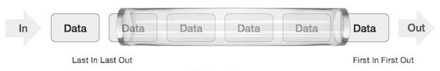
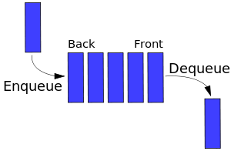
Queues
Joseph Marvin R. Imperial
DATA STRUCTURES AND ALGORITHMS
NU College of Computing and Information Technologies
Course Code: CCDATRCL

Slide 4
How do we manage priorities in queues?
Joseph Marvin R. Imperial
DATA STRUCTURES AND ALGORITHMS
NU College of Computing and Information Technologies
Course Code: CCDATRCL

Slide 5
Prioritization problems / urgency
Printing schedules – printers constantly accept and complete printing jobs from the network. Sometimes graduate students go first before undergrad, teacher go first before students, etc.
Emergency room scheduling – scheduling patients for treatment in the ER. A mother who is about to give birth would need to be prioritized before a patient with a minor cold (even though the patient got the hospital first).
Joseph Marvin R. Imperial
DATA STRUCTURES AND ALGORITHMS
NU College of Computing and Information Technologies
Course Code: CCDATRCL

Slide 6
Key operations we need
enqueue() / addMax(): Adding an element to the queue
dequeue() / removeMax() / poll(): getting the ‘most important’ element from the queue
peek(): know which element has the current highest priority
isfull(): Checks if the queue is full, if queue is implemented using static arrays
isempty(): Checks if the queue is empty.
display(): display the contents of the queue
Joseph Marvin R. Imperial
DATA STRUCTURES AND ALGORITHMS
NU College of Computing and Information Technologies
Course Code: CCDATRCL

Slide 7
Priority Queue ADT
A priority queue is an Abstract Data Type (ADT) that operates similar to a normal queue except that each element has a certain priority.
The priority of the elements in the priority queue determine the order in which elements are removed from the PQ.
Note: Priority queues only supports comparable data, meaning the data inserted into the priority queue must be able to be ordered.
Joseph Marvin R. Imperial
DATA STRUCTURES AND ALGORITHMS
NU College of Computing and Information Technologies
Course Code: CCDATRCL

Slide 8
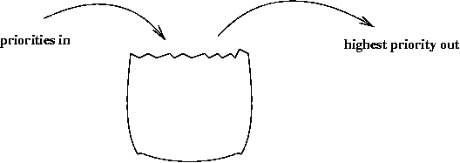
Priority Queue ADT
Joseph Marvin R. Imperial
DATA STRUCTURES AND ALGORITHMS
NU College of Computing and Information Technologies
Course Code: CCDATRCL

Slide 9
Priority Queue Rules
An element with high priority is served before an element with low priority.
If two elements have the same priority, they are served according to the order in which they were enqueued or
Ordering of elements with the same priority is undefined.
Joseph Marvin R. Imperial
DATA STRUCTURES AND ALGORITHMS
NU College of Computing and Information Technologies
Course Code: CCDATRCL

Slide 10
Implementations of PQs
PQ using an unsorted, static array
PQ using a sorted array
PQ using an unsorted linked list
PQ using a sorted linked list
Joseph Marvin R. Imperial
DATA STRUCTURES AND ALGORITHMS
NU College of Computing and Information Technologies
Course Code: CCDATRCL

Slide 11
PQs with unsorted, static arrays
If we use an unordered array then add will be simply putting another item onto the end of the array, which is O(1) assuming the array is large enough*.
peek() would require linear searching the entire array for the max value, which is O(N)**
removeMax() would requiring linear searching the entire array, finding the item, removing it, and shifting all the entries after it in order to remove the hole in the array. This is also O(N).
*cannot add more once full
**would also require extra memory to store current highest priority
Joseph Marvin R. Imperial
DATA STRUCTURES AND ALGORITHMS
NU College of Computing and Information Technologies
Course Code: CCDATRCL

Slide 12
PQs with sorted arrays
If we use a sorted array then add will need to search for the correct location to place the new item and then shift down all the items that follow that space and adding the item.
peekMax() would require simply returning the last item in the array, which is O(1).
removeMax() would require removing the last item and returning it, which would also be O(1).
Joseph Marvin R. Imperial
DATA STRUCTURES AND ALGORITHMS
NU College of Computing and Information Technologies
Course Code: CCDATRCL

Slide 13
PQs with unsorted linked list
If we use an unordered linked list then add will simply be adding to the head of the list, which is O(1).
peek() would require a full search of the list, similar with unsorted arrays
removeMax() would effectively be the same as peek()
Joseph Marvin R. Imperial
DATA STRUCTURES AND ALGORITHMS
NU College of Computing and Information Technologies
Course Code: CCDATRCL

Slide 14
PQs with sorted linked list
If we use a sorted linked list then add requires a full search in order to figure out where to put the new item
Assuming we store the nodes so that the highest priority item is the head of the list, then peek() and removeMax() become fast because the highest priority item is simply at the head of the list.
Joseph Marvin R. Imperial
DATA STRUCTURES AND ALGORITHMS
NU College of Computing and Information Technologies
Course Code: CCDATRCL

Slide 15
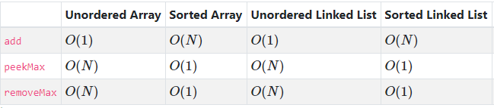
PQ Efficiency Summary Table
O(1) – really fast
O(N) – relative to size N
Joseph Marvin R. Imperial
DATA STRUCTURES AND ALGORITHMS
NU College of Computing and Information Technologies
Course Code: CCDATRCL

Slide 16
References
Standford CS 106B Lecture: Priority Queues and Heaps
Joseph Marvin R. Imperial
DATA STRUCTURES AND ALGORITHMS
NU College of Computing and Information Technologies
Course Code: CCDATRCL

